Slide 1


Smart Inventory Management System
Demand Forecasting, Inventory Optimization, and Real-Time Dashboard
Name:
Kunal Pawar
Tanuj Chopda
Shruti Shahare
Date: 13/11/2024
by Shruti Shahare

Slide 2

Project Overview
1
Objective
2
Components
Develop a smart inventory management system that utilizes real-time data to optimize inventory levels and ensure product availability.
The system comprises a demand forecasting model, an inventory optimization algorithm, and a real-time dashboard for monitoring performance.
3
Goal
Minimize holding costs, such as storage and warehousing expenses, while ensuring product availability to meet customer demand.

Slide 3
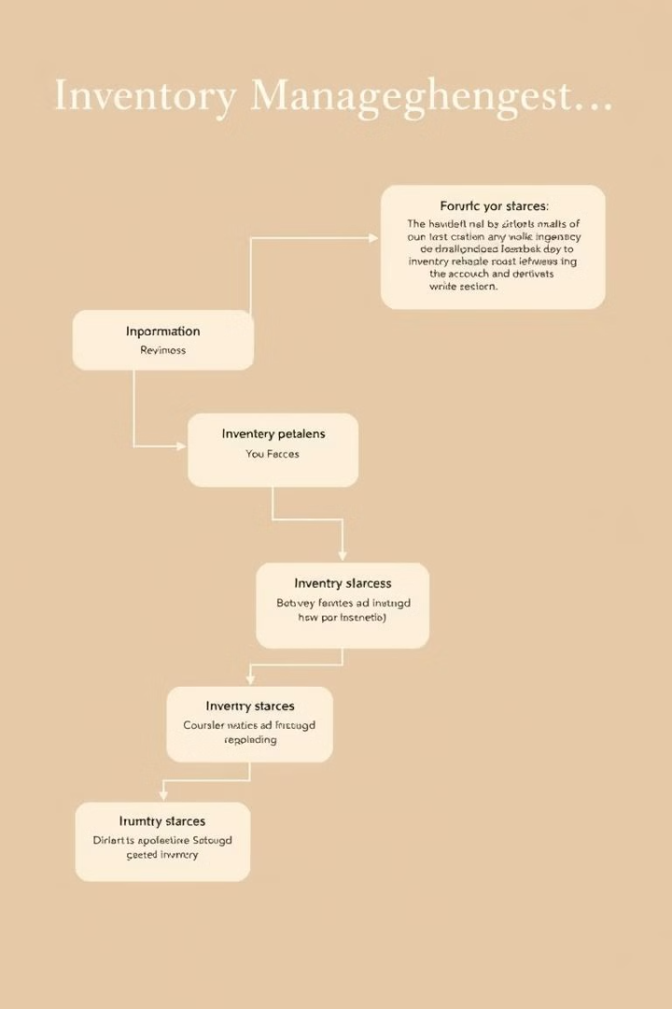
Methodology
1
Demand Forecasting
Utilize time series analysis or machine learning models to predict future demand based on historical data and external factors.
2
Inventory Optimization
Employ algorithms to determine optimal reorder points and quantities, considering factors such as lead time, demand variability, and desired service levels.
3
Real-Time Dashboard
Develop a user-friendly interface that provides real-time visibility into inventory levels, sales data, and supply chain performance.

Slide 4
Data Collection and Transformation
Data Source:
ETL Process:
Simulated data for products, sales, and inventory.
Extract: Collect historical sales data. Transform: Clean, normalize data (e.g., handle missing values). Load: Store the transformed data in a DataFrame for analysis. Tools: Python (Pandas, NumPy), Streamlit for visualization

Slide 5
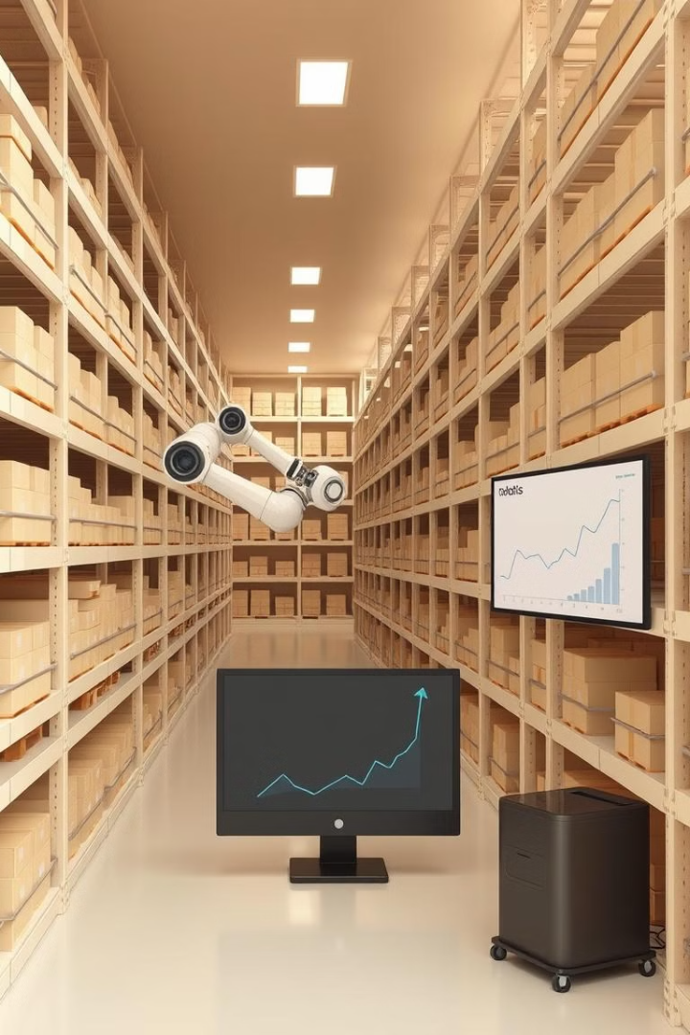
Demand Forecasting Model
Forecasting Methods
Performance Evaluation
Time Series Models or Machine Learning Algorithms (e.g., XGBoost)
Metrics: Accuracy, Precision, Recall (based on the forecast vs. actual data).
Visual Output:
Line chart comparing forecasted sales with actual sales

Slide 6
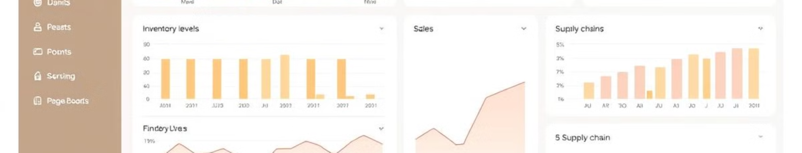
Inventory Optimization Algorithm
Key Concepts:
Formulae:
Safety Stock: Ensures availability during demand fluctuations.
Safety Stock = Z * σ * sqrt(Lead Time) Reorder
Point = (Avg. Demand * Lead Time) + Safety
Reorder Point: The inventory level at which a reorder is triggered.
Stock EOQ = sqrt((2 * Demand * Order Cost) / Holding Cost)
Economic Order Quantity (EOQ): The optimal order quantity to minimize costs.
Output: Calculated reorder points and EOQ for stock replenishment.

Slide 7
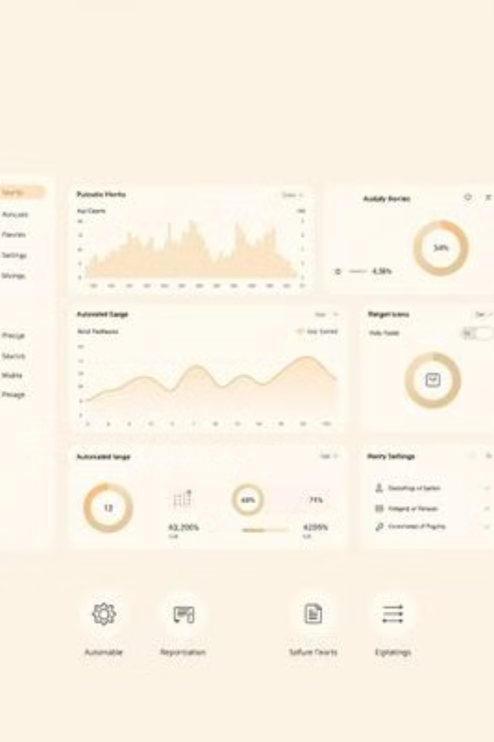

Real-Time Dashboard Visualization
Features:
Inventory Levels vs. Forecasted Demand: Line chart showing stock vs forecast.
Inventory Metrics: Average demand, safety stock, reorder point, and EOQ.
Actionable Insights: Recommendations for stock replenishment.
Tools Used: Streamlit for creating interactive visualizations.
User Input: Lead time, ordering cost, holding cost, etc.

Slide 8




Key Findings & Recommendations
Demand Forecast Accuracy:
Accurate demand predictions based on historical data.
Inventory Optimization:
Optimal inventory levels that minimize costs and avoid stockouts
Replenishment Strategy:
Recommendations on reorder points and EOQ for efficient stock management.

Slide 9
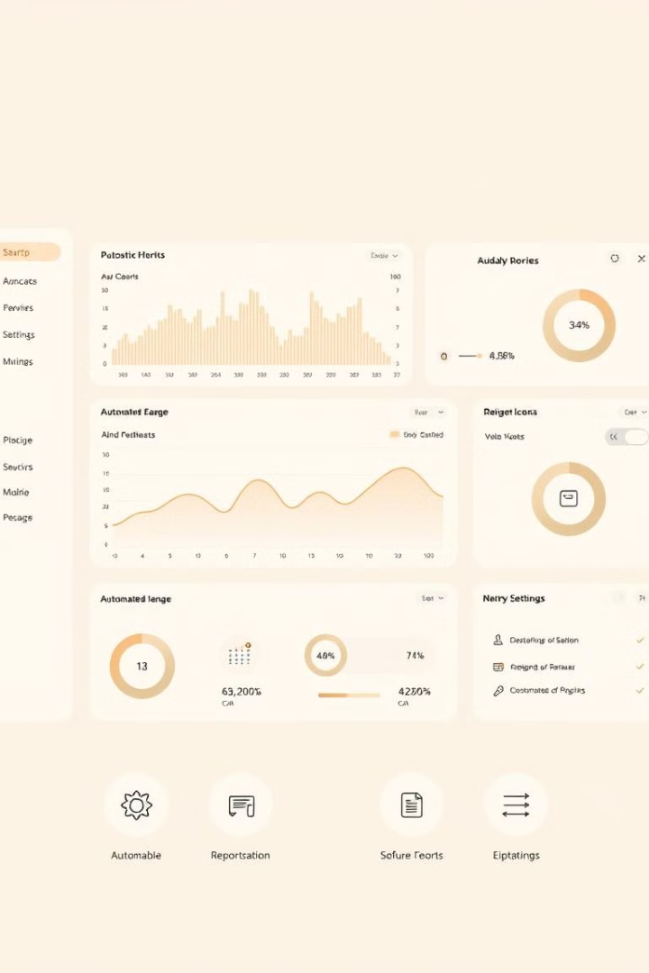
Conclusion
1
The Smart Inventory Management System improves efficiency and reduces costs.
2
Actionable insights from the dashboard help inventory managers make informed decisions.
3
Future work: Implement machine learning models for even more precise forecasting and optimization.

Slide 10

Thank You
Contact details
Kunal Pawar (878 868 4026)
Tanuj Chopda (77458 25978)
Shruti Shahare (9145746259)

